Slide 1
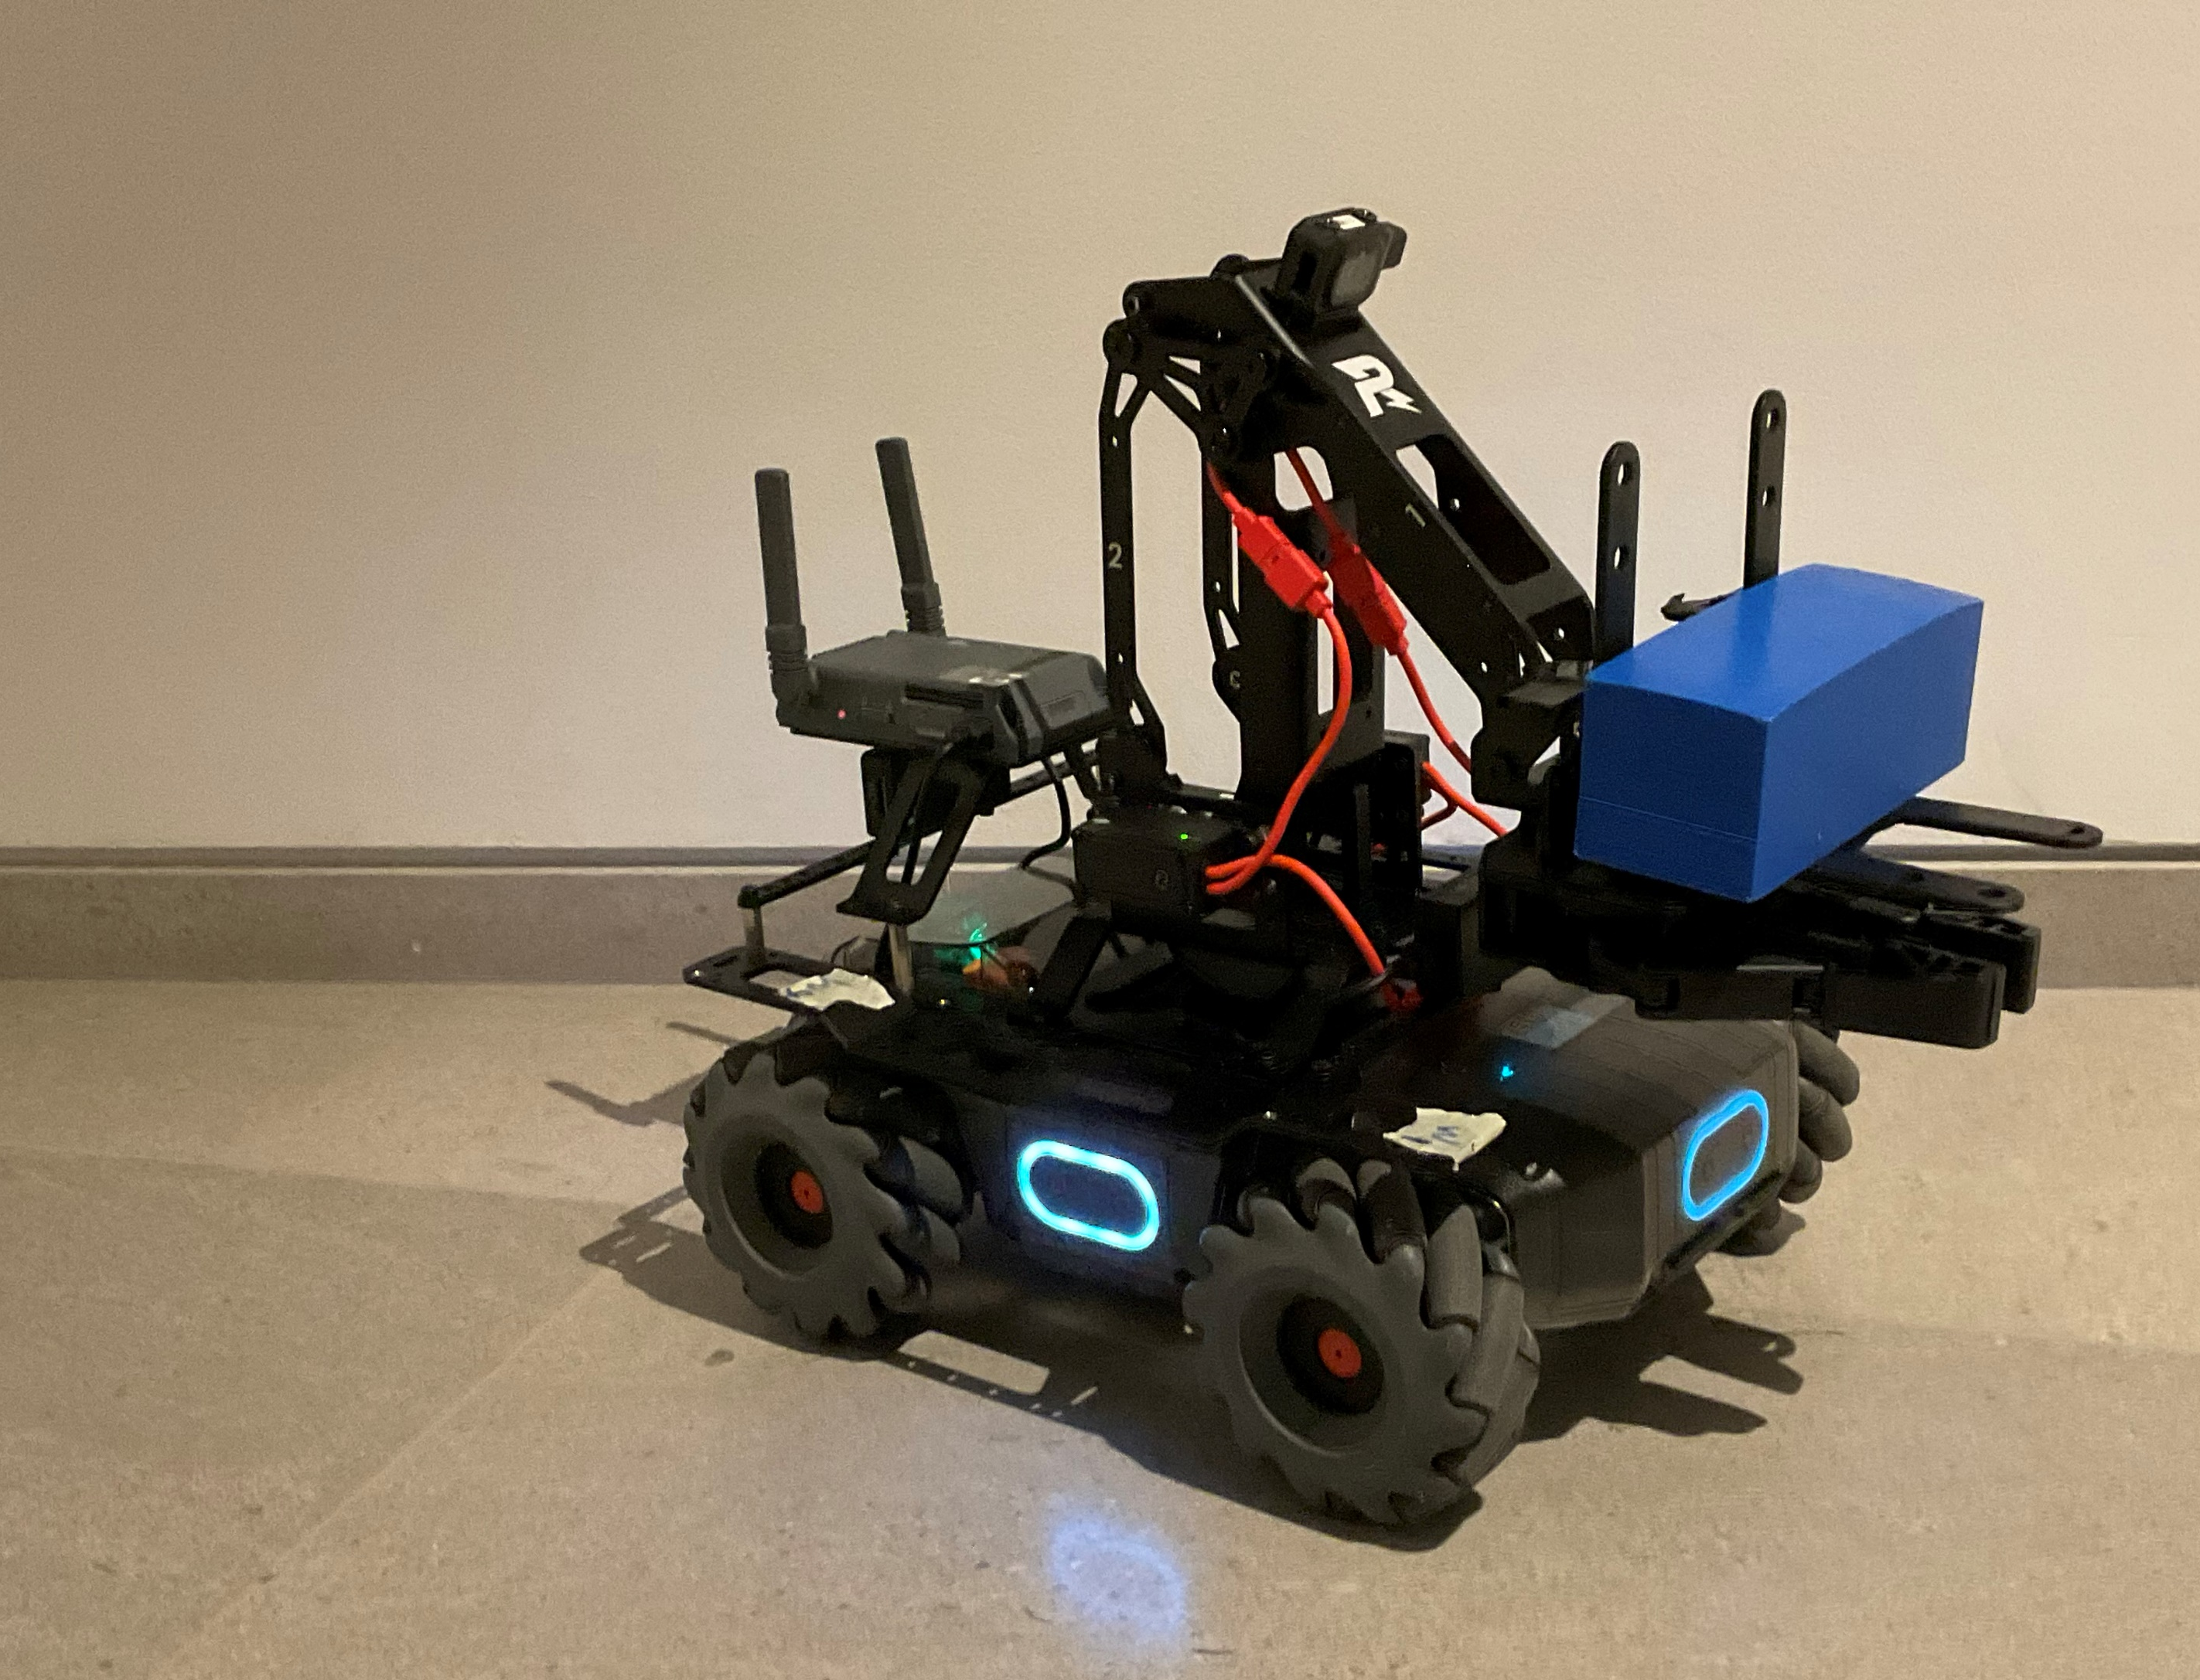
“Don’t Drop the Package” Autonomous Forklift
Avigail Ben Eliyahu
Guy Eisenberg
Inbar Strull (partial contribution)

Slide 2
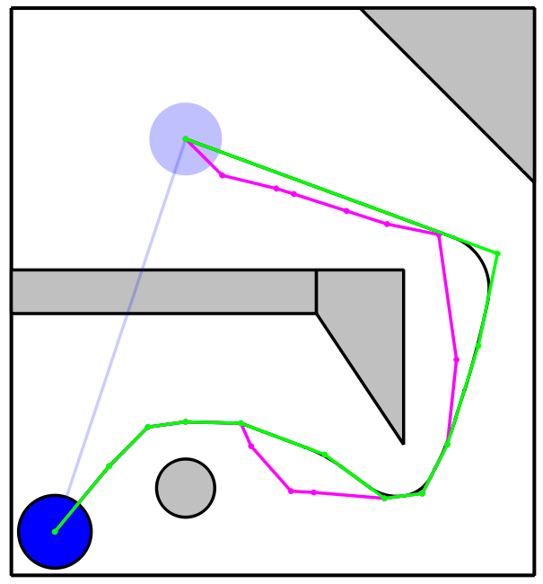
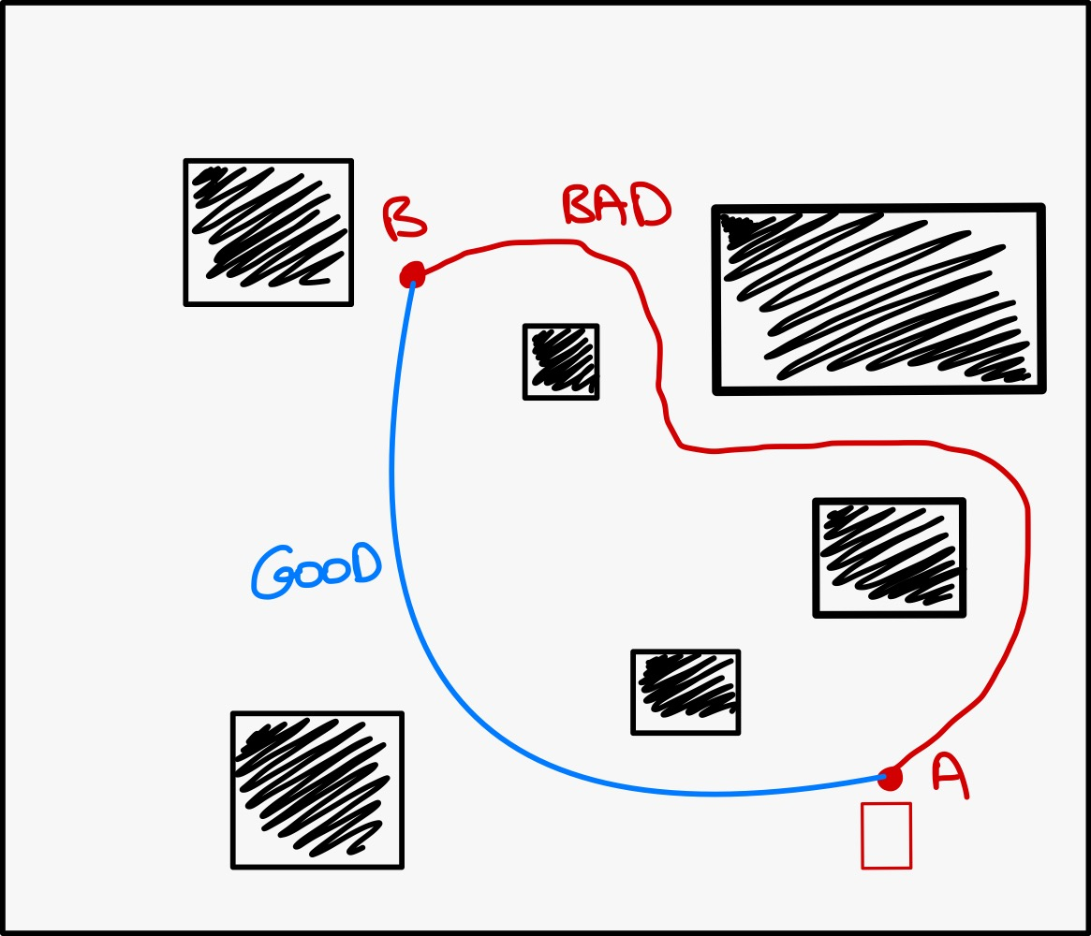
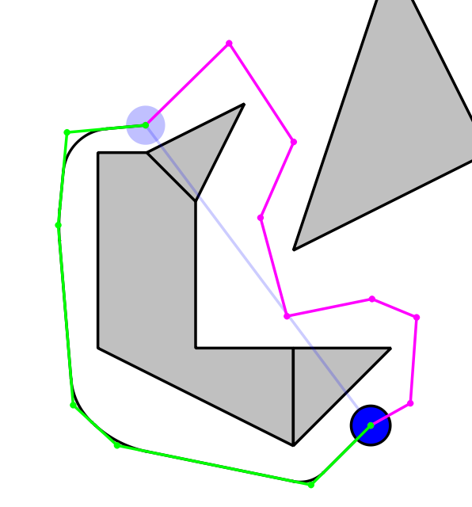
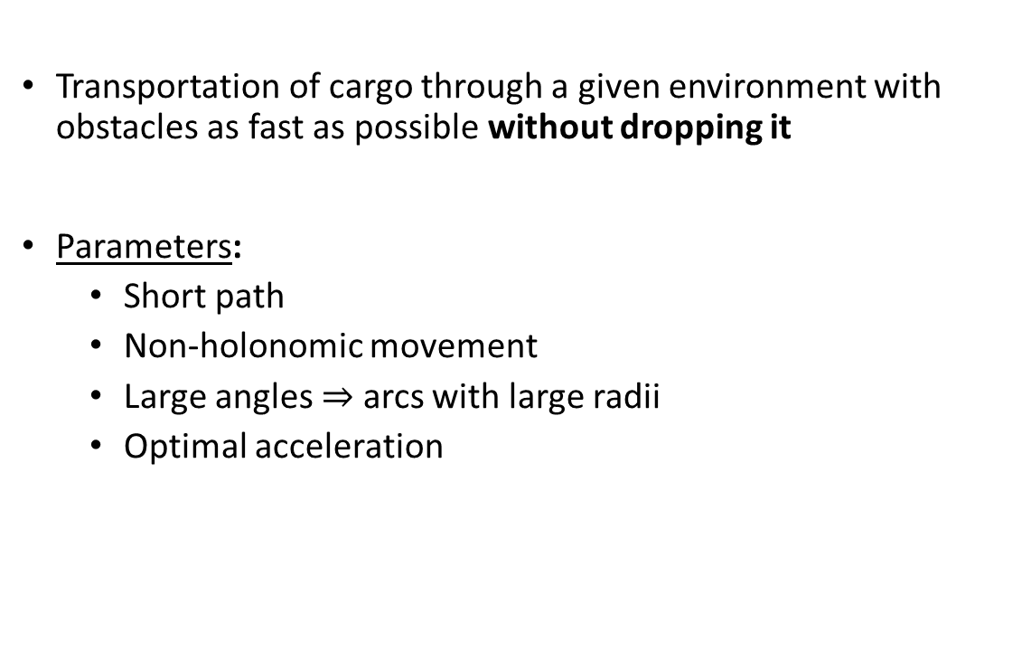
Project Goal
Transportation of cargo through a given environment with obstacles as fast as possible without dropping it
Parameters:
Short path
Non-holonomic movement
Large angles $⇒$ arcs with large radii
Optimal acceleration

Slide 3
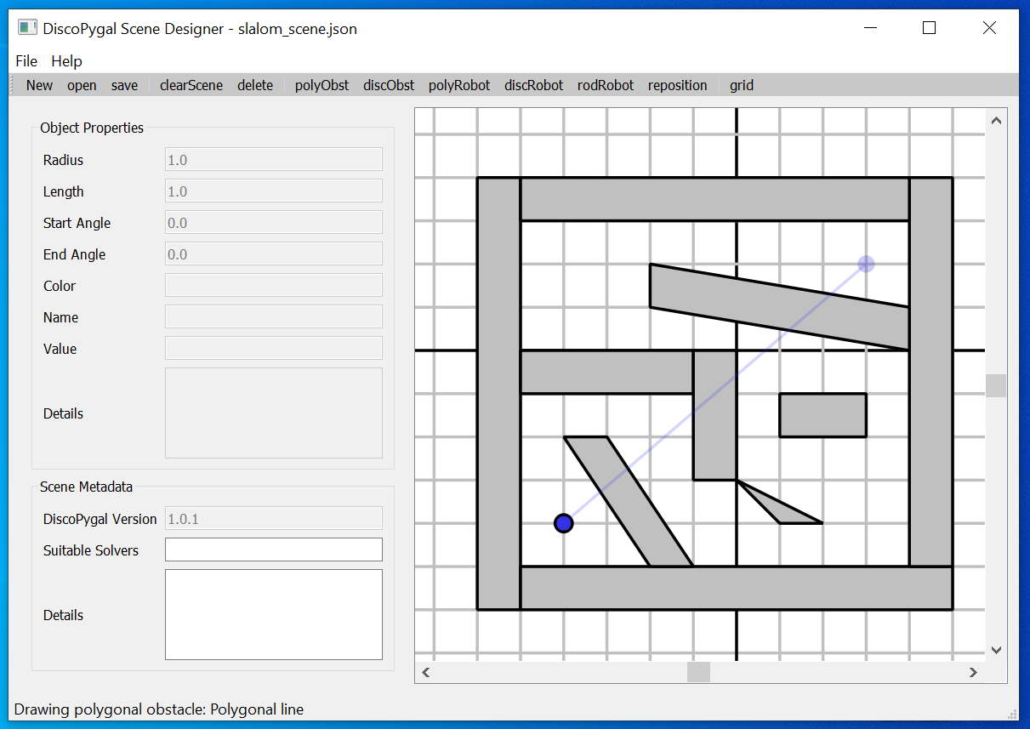
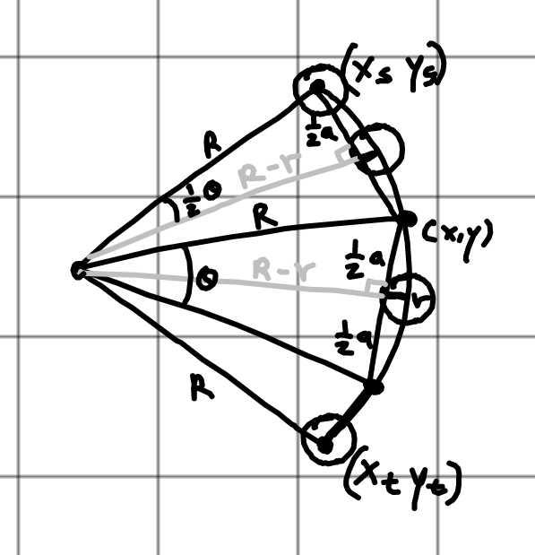
Technical Details
Assumptions:
Map is known to the robot
Static obstacles
Tools:
Physical robot Robomaster EP Core
CGAL Python bindings
DiscoPygal
Geometric calculations
Mechanics force calculations

Slide 4
Achieving the Goal Robot-wise
Comfortable API for non-holonomic movement
Accelerating/decelerating straight line
Circular arc with constant speed
Finding the robot’s upper-limit acceleration from empiric measurements

Slide 5
Achieving the Goal Path-wise
PRM from DiscoPygal
Choice of optimal route (not necessarily the shortest)
Douglas Peuker Algorithm
Finding the optimal curve radius for each turn
Calculation the robot’s speed for every route section based on the upper-limit

Slide 6
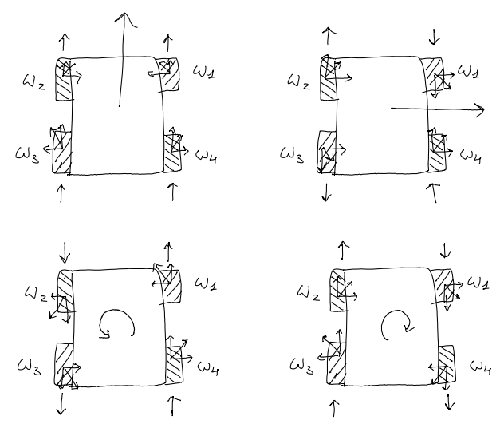
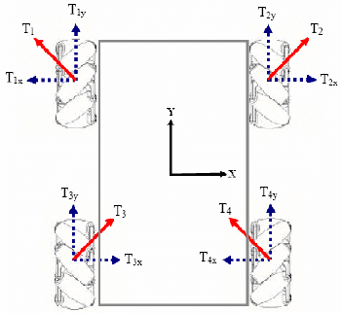
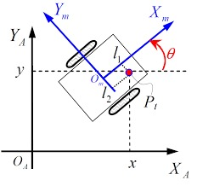
RoboMaster API
Controlling robot movement using its Mecanum Wheels
Setting the rotation speed of each wheel to obtain pure rotation, pure translation or arc movement

Slide 7
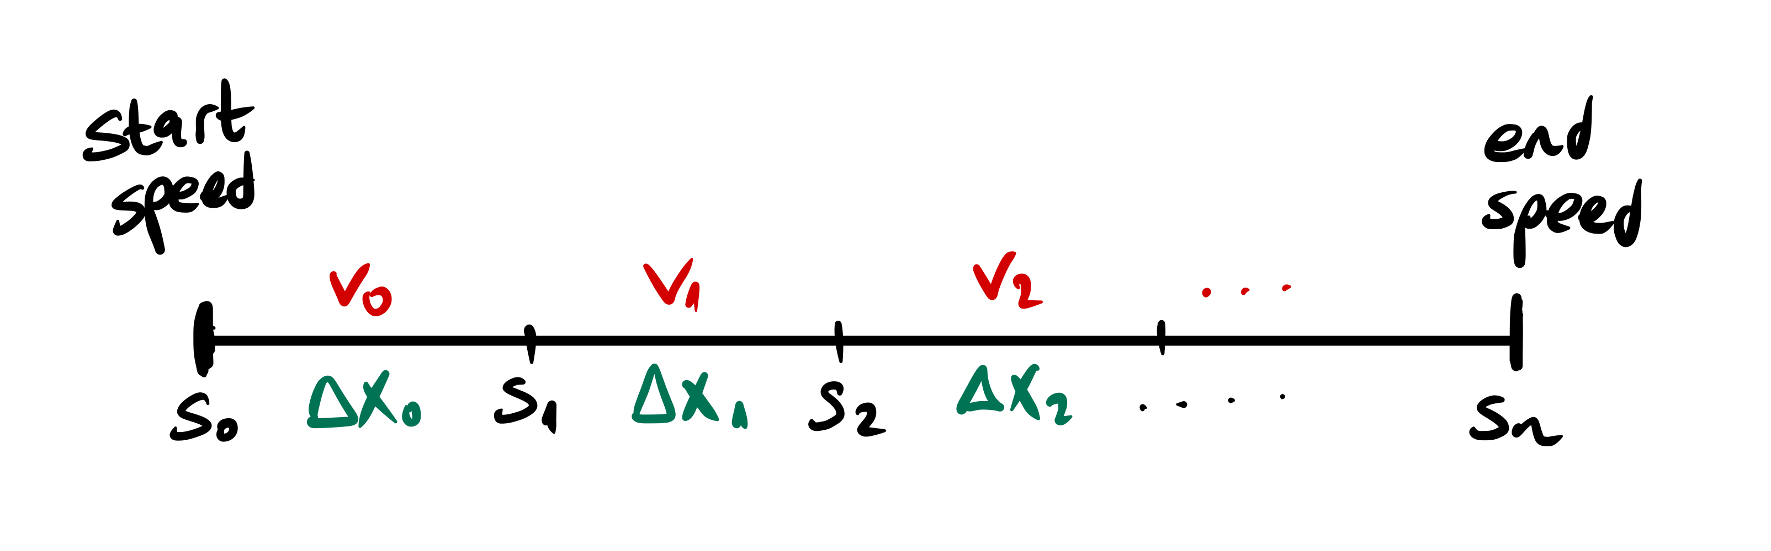
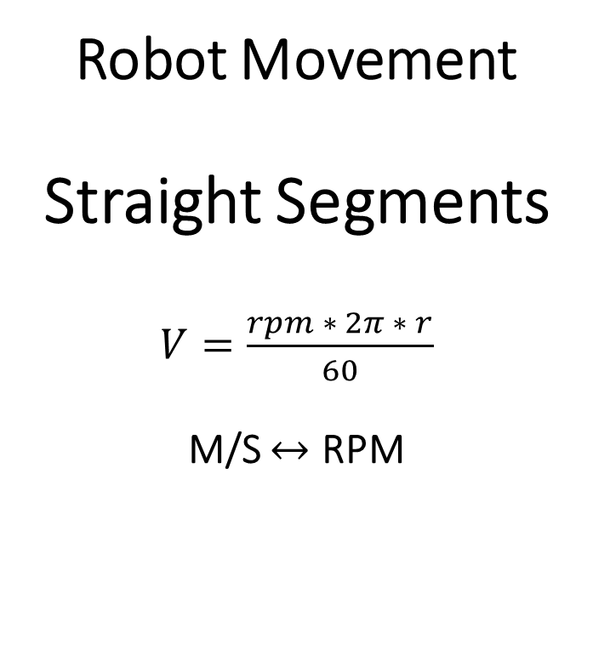
Robot Movement Straight Segments $V=\frac{rpm ∗ 2π ∗ r}{60}$ M/S $↔$ RPM
The challenge is to “glide” through speeds:
Sub-divide motion through each segment into smaller segments with different speeds
This is how we control acceleration:

Slide 8
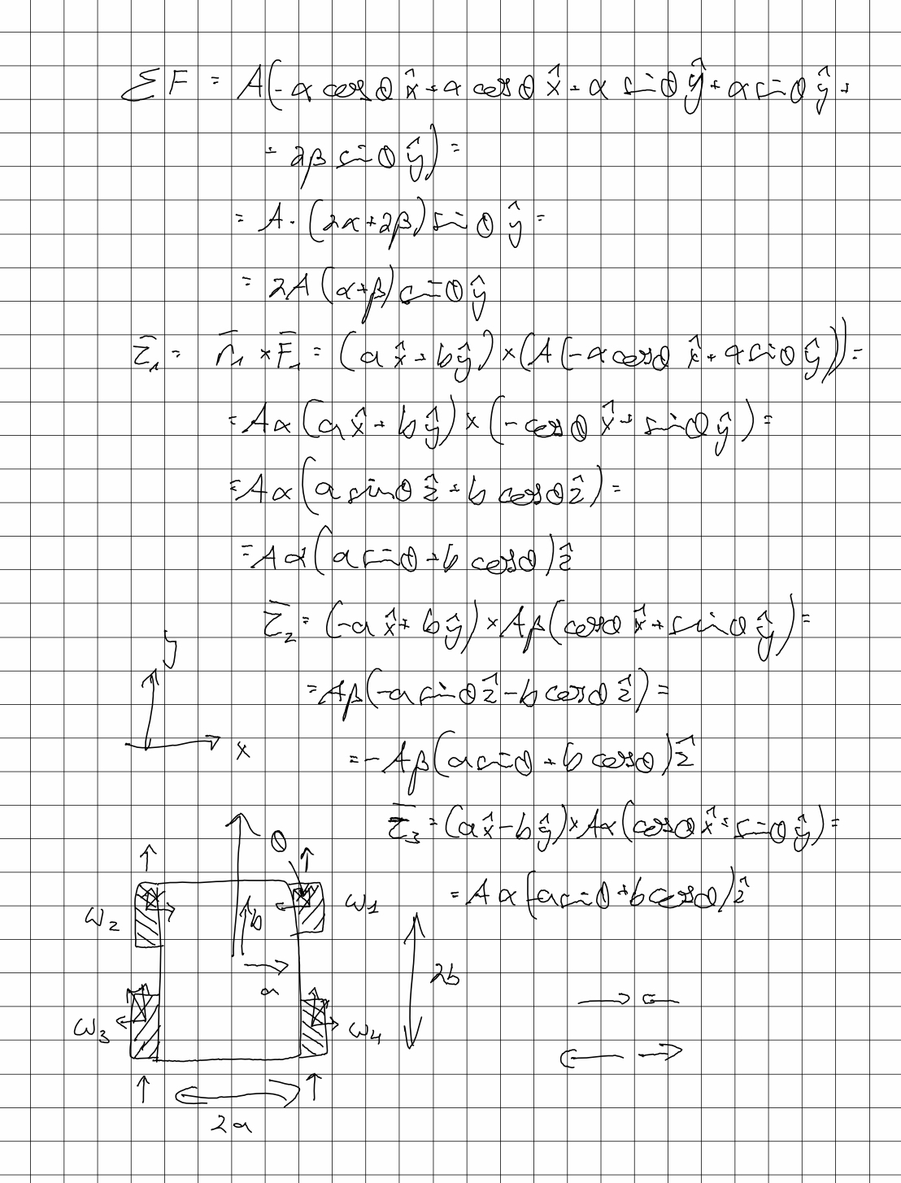
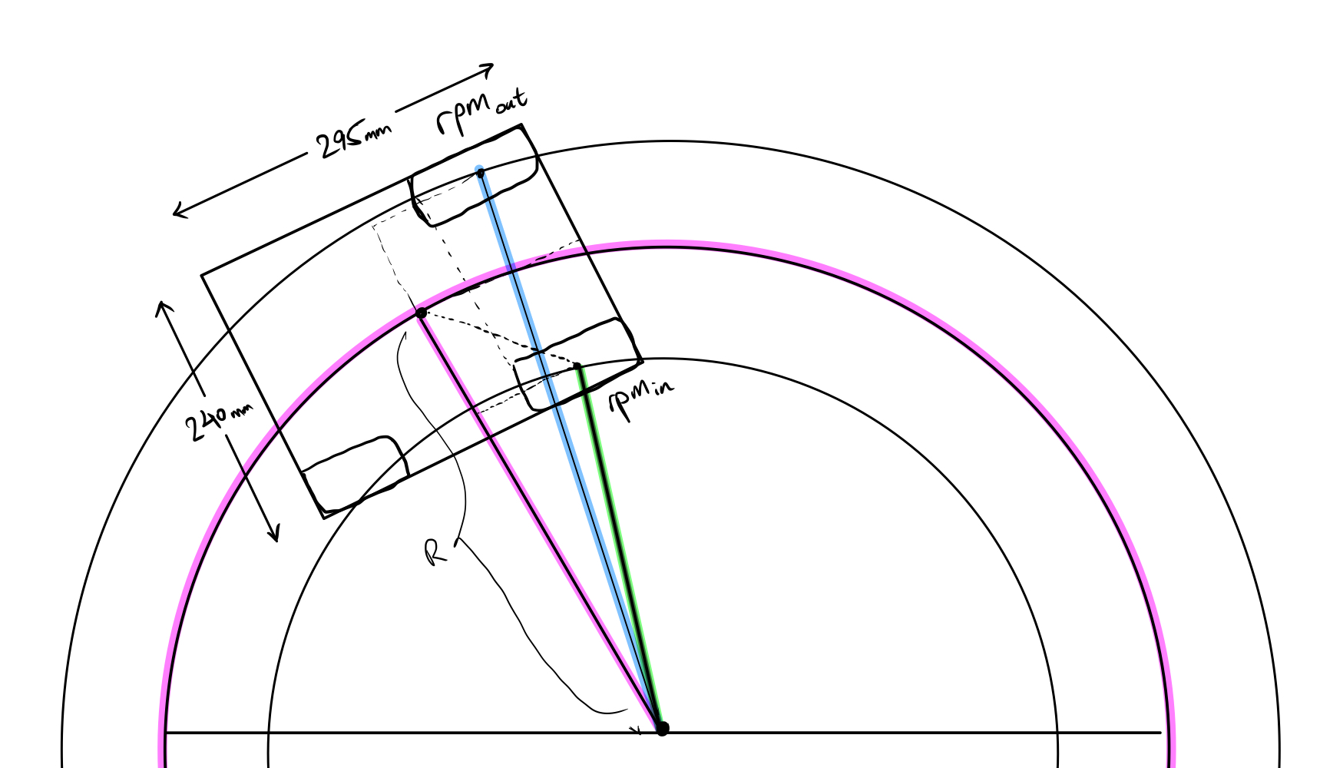
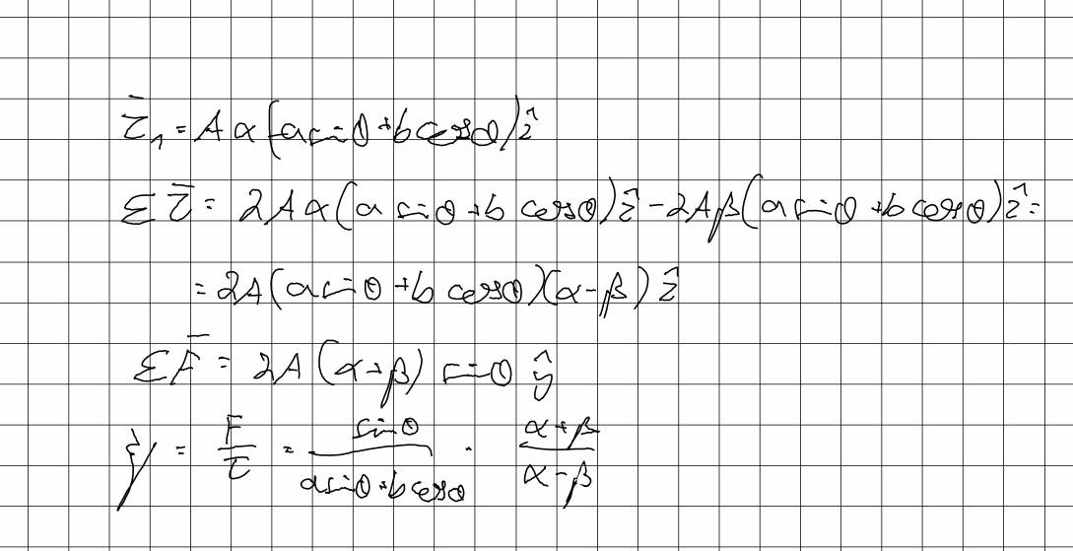
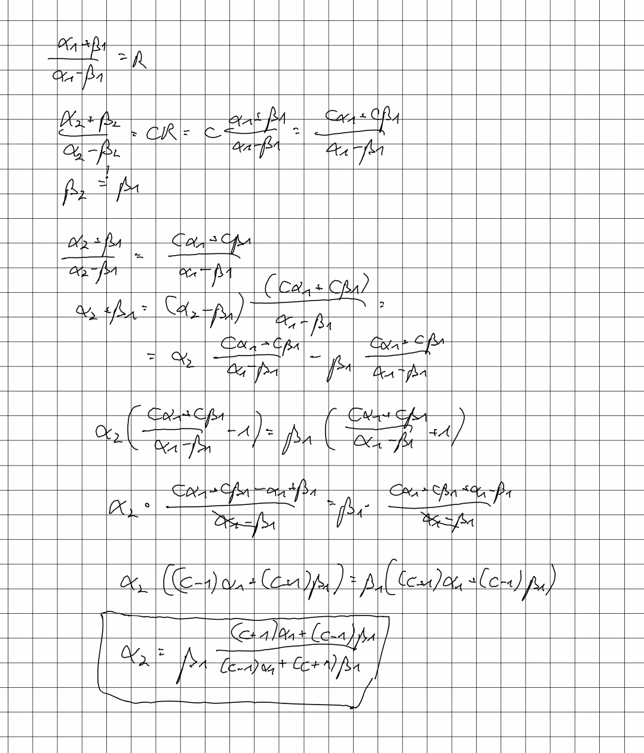


Robot Movement Circular Arcs Physics FTW Credit to Shahar Simon
$$rpm_{out}=\frac{rpm∗\left(const+R\right)}{R}$$
$$const=\frac{asinθ+bcosθ}{sinθ}=…=\frac{1}{5}$$

Slide 9
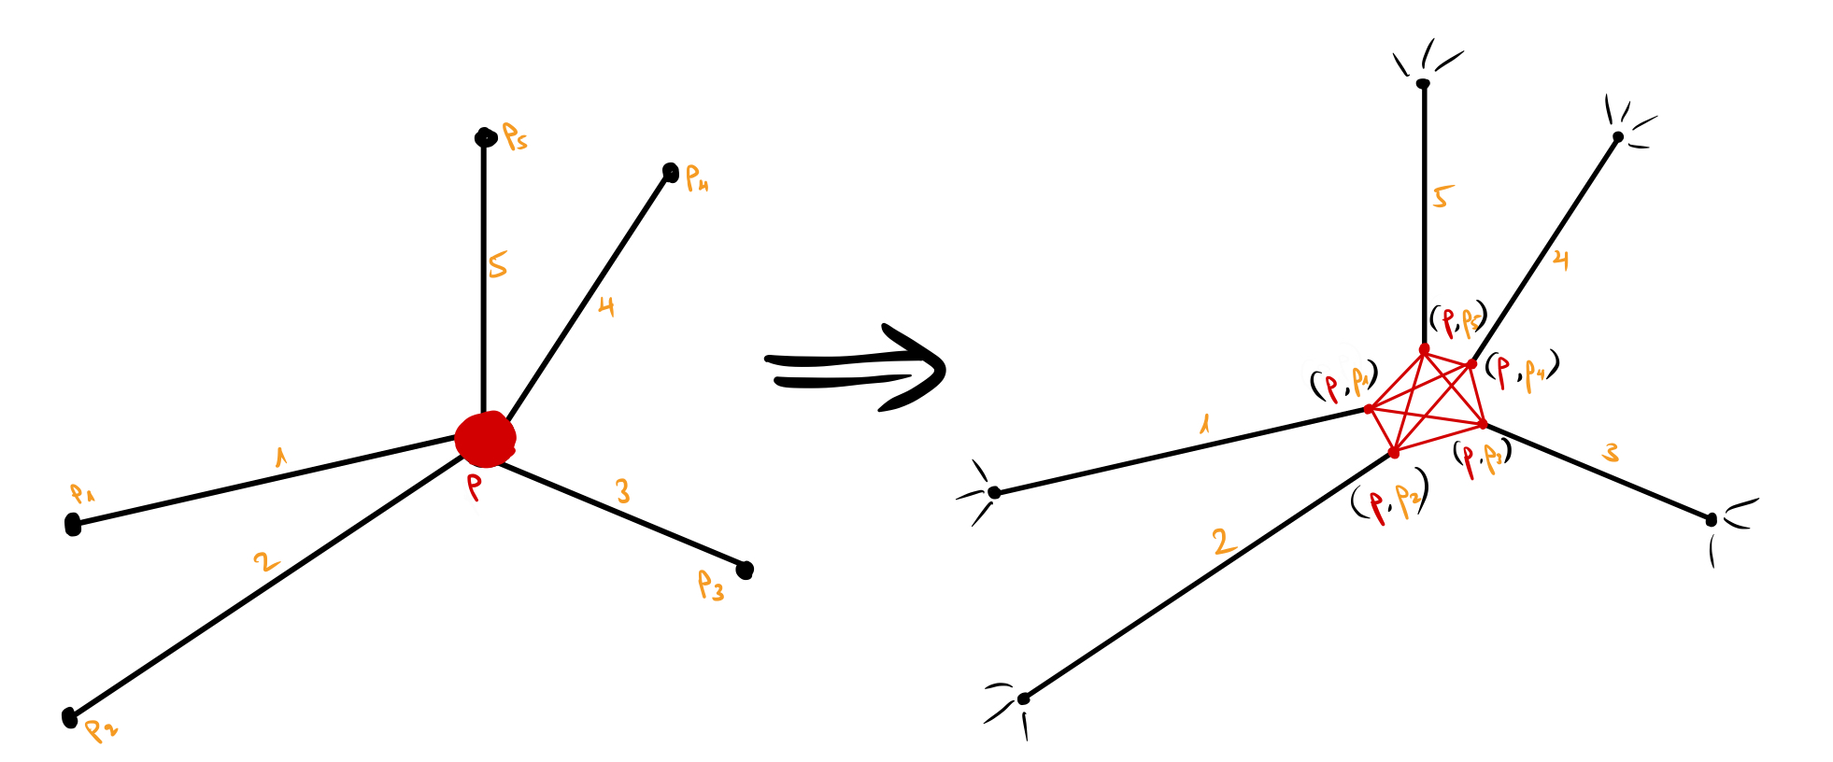
Sample points and connect to the k nearest neighbors if possible (collision detection)
Give less weight to wider angles, and use Dijkstra’s algorithm
Path Calculations Configuration Graph

Slide 10
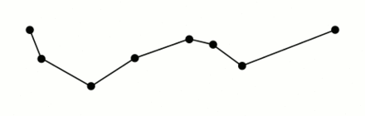
Path Calculations Reducing Points
Douglas Peuker
Using Douglas Peuker algorithm considering collision detection

Slide 11
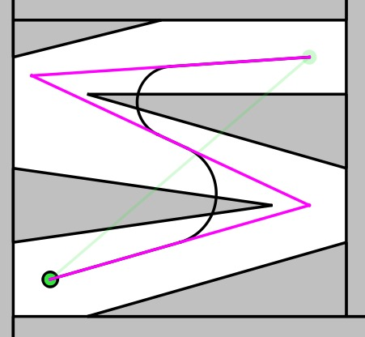
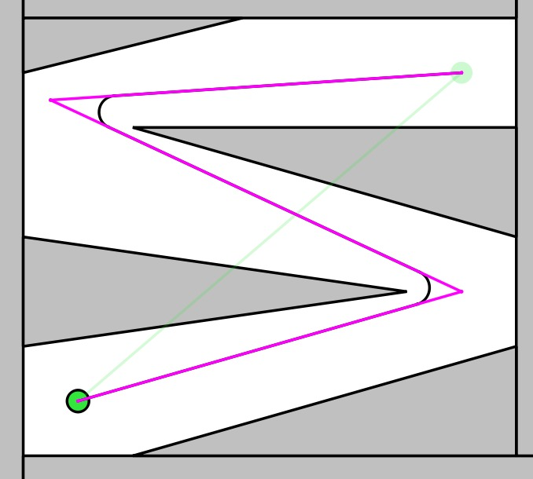
For a given turn, fit a circle that
is tangent to both segments
goes through the closer midpoint
Calculate the arc start and end points
Check if the arc collides with an obstacle using a custom collision detector for arcs
If the arc does collide, perform a binary search to find the optimal arc that does not
Path Calculations Smoothing Turns Using Circular Arcs

Slide 12
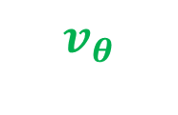
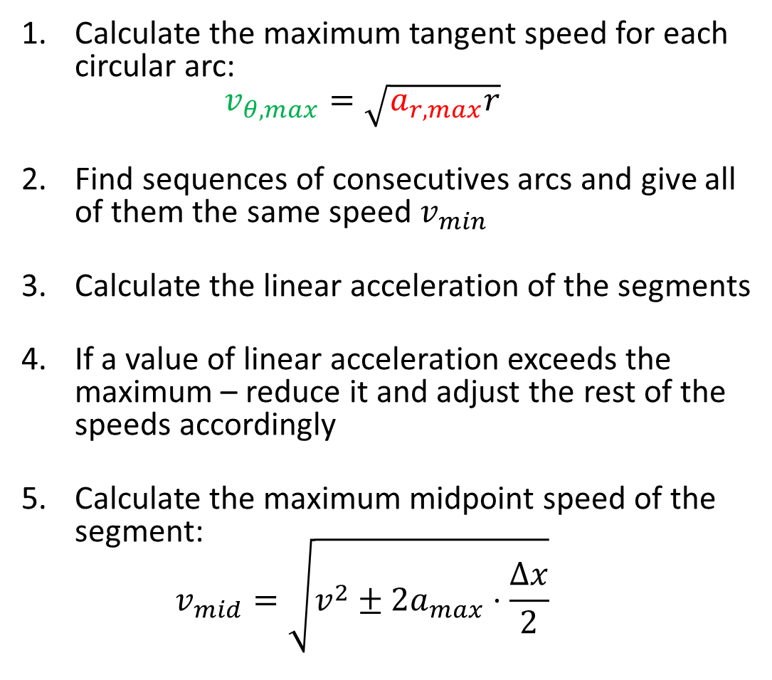
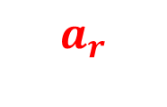
Calculate the maximum tangent speed for each circular arc: $v_{θ,max}=\sqrt{a_{r,max}r}$
Find sequences of consecutives arcs and give all of them the same speed $v_{min}$
Calculate the linear acceleration of the segments
If a value of linear acceleration exceeds the maximum – reduce it and adjust the rest of the speeds accordingly
Calculate the maximum midpoint speed of the segment: $v_{mid}=\sqrt{v^{2}±2a_{max}⋅\frac{Δx}{2}}$
Path Calculations Calculating Optimal Speeds
$$a_{r}$$
$$v_{θ}$$

Slide 13
Future Potential Improvements
Fix tangential speed of short arcs
Acceleration during circular arc motion
Optimize path by traversal time
Sample in a 3D configuration space that includes the azimuth of the robot
Using C-PRM and Path Hybridization

Slide 14
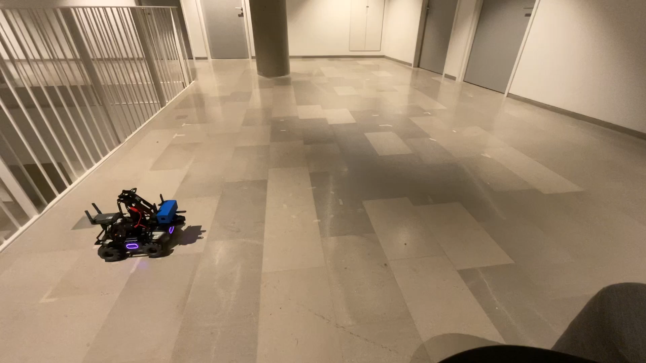
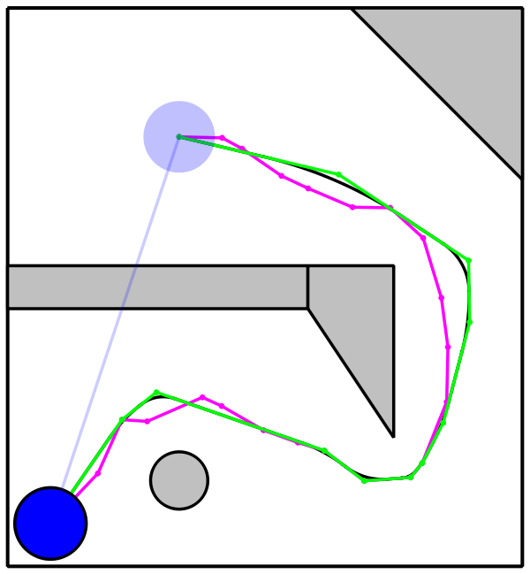
Visuals

